Slide 1

superior Employee Privacy Practices
How to design and execute it

Slide 2

AGENDA
INTRODUCTION
Key Considerations for Employee Privacy
Core Frameworks for Privacy Practices
Identifying Security Implications
Addressing Privacy Challenges
Implementation of privacy based system

Slide 3

Introduction
Importance of Employee Privacy Practices

Slide 4

I. Employee privacy practices are crucial for fostering trust, protecting sensitive data, and ensuring compliance with legal regulations. II. By respecting employee privacy, organizations not only meet ethical and legal obligations but also enhance workplace morale and safeguard their reputation. III. Prioritizing privacy demonstrates a commitment to transparency and security, ultimately supporting a more productive and positive organizational culture.

Slide 5

Ethical Responsibility: Ensures trust and ethical treatment of employees.
Regulatory Compliance: Meets data protection laws like GDPR, CCPA, and HIPAA.
Business Reputation: Demonstrates commitment to employee welfare, attracting talent and maintaining organizational credibility.
Operational Efficiency: Reduces risk of disputes related to data misuse or breaches.

Slide 6
Key Considerations for Employee Privacy
Trust & boundaries

Slide 7
Ethical Responsibility
Respecting Personal Boundaries: Employees expect their personal information to be handled with respect and discretion.
Building Trust: Clear privacy practices and empathy promote trust between the organization and employees, which is essential for a positive work environment.
Corporate Social Responsibility: Ethical handling of employee data aligns with broader corporate values of fairness, respect, and responsibility.
Regulatory Compliance
Meeting Legal Requirements: Privacy laws like GDPR, CCPA, and HIPAA require organizations to protect personal data and be transparent in its usage.
Avoiding Legal Risks: Non-compliance can lead to fines, legal actions, and reputational damage.
Global Considerations: As regulations evolve, companies must stay up to date on privacy requirements across different jurisdictions.

Slide 8
Impact on Business Reputation
Public Perception: Companies with robust privacy practices are viewed as more trustworthy and responsible.
Attraction and Retention of Talent: Employees are more likely to join and stay with organizations that prioritize their privacy and data security.
Customer Trust: Strong privacy practices extend beyond employees, influencing customer confidence in the organization’s data handling.
Operational Efficiency
Minimizing Risks: A well-structured privacy policy can help identify and mitigate data security threats before they become major issues.
Streamlined Processes: Clear privacy guidelines ensure consistent practices across the organization, improving efficiency and reducing confusion.
Employee Satisfaction: Transparent privacy policies lead to fewer concerns and distractions, allowing employees to focus on their work.

Slide 9

Core Frameworks for Privacy Practices
Effective employee privacy management relies on core frameworks. These practices ensure ethical data handling, regulatory compliance, and reduced risks, fostering trust and organizational resilience.

Slide 10
Frameworks
Privacy-by-Design
Proactive Approach: Integrate privacy considerations into systems and processes from the beginning rather than as an afterthought.
Secure Technology: Use secure platforms and ensure privacy safeguards are built into tools and applications used by employees.
Continuous Review: Regularly assess and improve privacy practices to adapt to new challenges and technologies.
Data Minimization
Essential Data Only: Collect and retain only the information necessary for specific operational purposes.
Avoid Over-Collection: Refrain from gathering excessive or irrelevant data, such as unnecessary personal identifiers or behavioral tracking.
Retention Policies: Establish clear guidelines for securely deleting outdated or redundant employee information.

Slide 11
Frameworks
Transparent Policies
Clear Communication: Ensure employees understand what data is collected, how it’s used, and why it’s necessary.
Informed Consent: Obtain explicit consent where required, particularly for sensitive data or monitoring activities.
Feedback Mechanisms: Provide channels for employees to ask questions or express concerns about privacy practices.
Access Control
Role-Based Access: Limit access to sensitive data based on job roles and responsibilities to reduce exposure.
Authentication Protocols: Implement robust login security measures, such as multi-factor authentication (MFA).
Audit Trails: Maintain logs to monitor and review access to sensitive employee information.

Slide 12

Identifying Security Implications
The cost of neglecting employee data privacy isn’t just financial—it’s the loss of trust, reputation, and integrity.

Slide 13

Data Breaches
Unauthorized access to employee data can lead to identity theft, fraud, and significant financial and reputational damage.
Protecting sensitive information requires robust security measures, including encryption and monitoring.
Internal Threats
Insiders, whether malicious or negligent, can misuse employee data, exposing the organization to serious risks.
Regular audits and access controls are essential to mitigate this risk.

Slide 14
Security implications
Legal and Compliance Risks
Failure to comply with data protection regulations like GDPR or CCPA can result in heavy fines, lawsuits, and operational setbacks.
Staying updated with evolving laws ensures regulatory alignment and reduces liability.
Erosion of Trust
Mishandling employee data undermines trust, affecting morale, productivity, and organizational culture.
Transparent privacy practices are key to maintaining trust and engagement.
Third-Party Risks
External vendors and service providers with access to employee data may become weak links in the security chain.
Conducting thorough due diligence and ensuring strong contractual protections is vital.

Slide 15
Addressing Privacy Challenges
Proactive measures today are the foundation of a secure and privacy-conscious workplace tomorrow.

Slide 16
Solutions & suggestions
Enhancing Data Security: Implement advanced security measures like encryption, multi-factor authentication (MFA), and regular security audits to safeguard sensitive data.
Promoting Transparency: Use clear privacy notices to inform employees about data practices and actively involve them in policy development to build trust.
Oversight Mechanisms: Appoint a Data Protection Officer (DPO) to oversee compliance and establish whistleblowing channels for reporting data concerns.

Slide 17

Mitigating Surveillance Risks: Adopt purpose-driven monitoring practices, ensuring surveillance is limited to operational necessities and respects employee privacy.
Training Programs: Conduct regular training on privacy best practices, covering data security, phishing awareness, and secure device usage.
Technology Solutions: Utilize Privacy-Enhancing Technologies (PETs), Data Loss Prevention (DLP) tools, and encryption software to protect data at all levels.

Slide 18
Implementation of privacy based system
Design & demonstration.

Slide 19
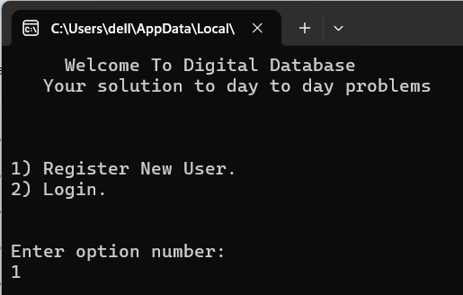
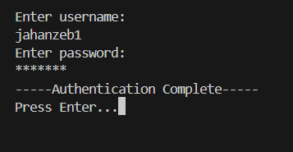
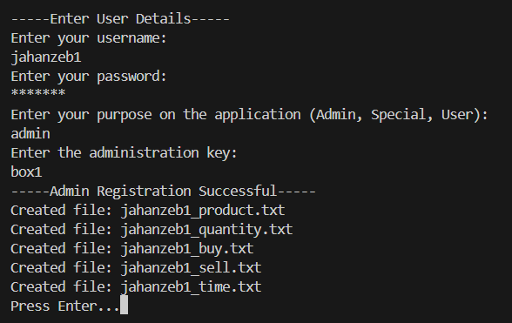
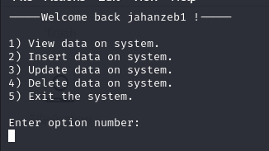
Implementation of digital database

Slide 20
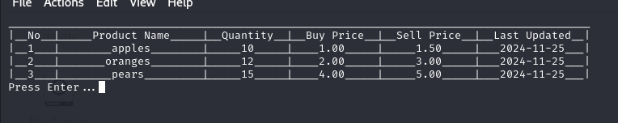
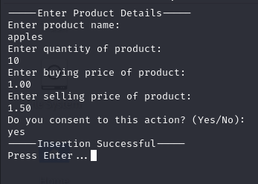
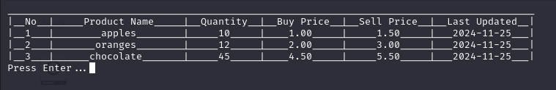
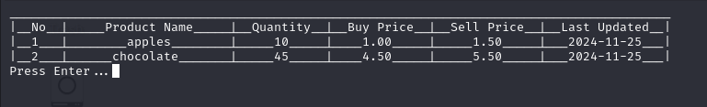
Implementation of digital database

Slide 21
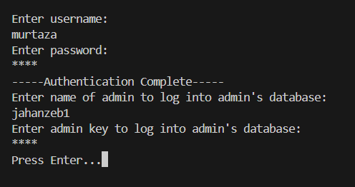
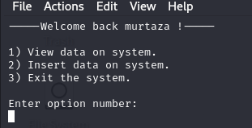
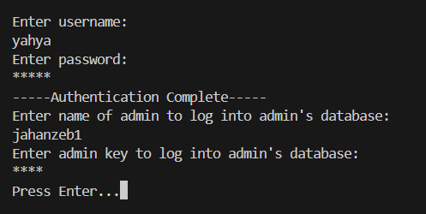
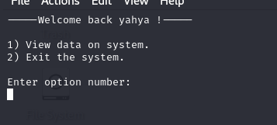
Implementation of digital database

Slide 22

Jahanzeb Khairi (22K-4746) S. M. Murtaza Rizvi (22k-4754) M. yahya khan (22K-4690) all three of us from for listening Thank you
Any Questions ?

